Slide 1


MAJOR PROJECT PRESENTATION
MAJOR PROJECT PRESENTATION ON
Vision-Based Brain Tumor Detection
Using Deep Learning
SUBMITTED BY:
Nitya Soni (2300971540088)
Prakash Narayan (2300971540090)
Prajwal Gupta (2300971540089)
Sarthak Kumar (2300971540117)
Under the Supervision of Project Guide:
Dr. Lubna Ansari
Galgotias College of Engineering & Technology, Greater Noida

Slide 2
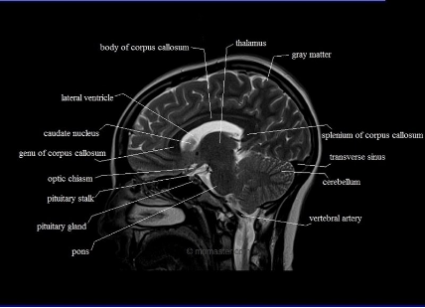
OUTLINE
Presentation Roadmap
Clinical Context
Alignment with SDGs
Problem Statement
Literature Survey
Research Gap
Methodology Flow
CNN Architecture
Result Analysis
Conclusion
References
FIG 1.1: HUMAN BRAIN NEURO ANATOMY

Slide 3
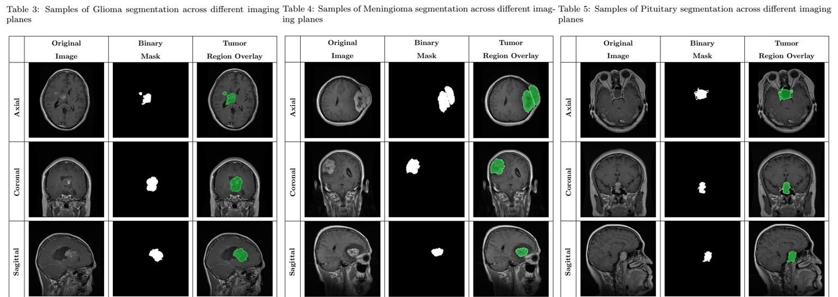

INTRODUCTION
Clinical Context & The AI Advantage
Brain tumours present high mortality risks. MRI is the standard diagnostic tool, but manual interpretation is slow, subjective, and prone to fatigue.
Vision-Based Diagnostics
Computer-Aided Diagnosis (CAD) using Convolutional Neural Networks (CNNs) automates the precise detection of complex variants like Glioma, Meningioma, and Pituitary tumours.
FIG 2.1: MULTI-MODAL BRAIN MRI SCANS

Slide 4



SDG ALIGNMENT
United Nations Sustainable Development Goals
SDG 3: Good Health & Well-being
Enhancing patient survival rates by drastically reducing the turnaround time for critical neuro-oncology diagnoses.
SDG 9: Industry & Innovation
Modernizing medical infrastructure by integrating reliable, explainable AI into daily healthcare workflows.
FIG 3.1: SDG 3
FIG 3.2: SDG 9

Slide 5
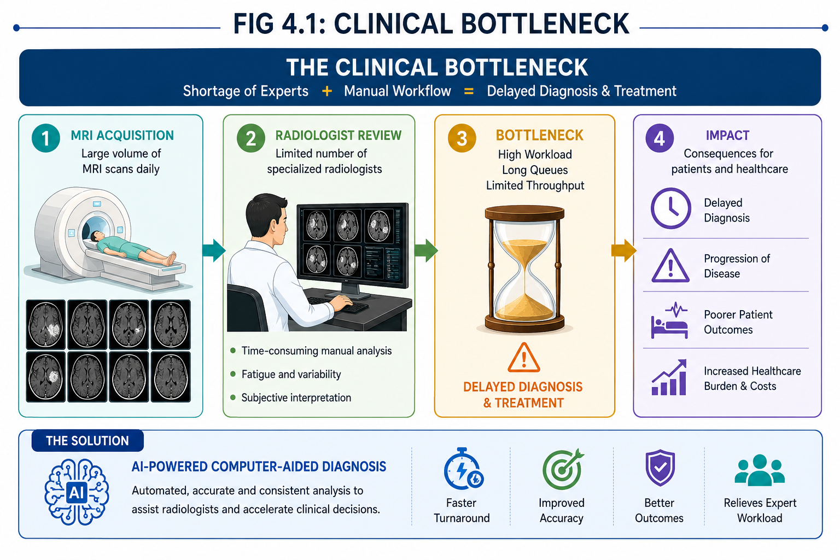
PROBLEM STATEMENT
Problem Statement & Objectives
The Core Problem: The global shortage of specialized neuro-radiologists
creates a diagnostic bottleneck. Existing AI models fail to gain clinical trust due to their "Black Box" nature.
Project Objectives:
To engineer a highly accurate, multi-class
CNN classification system using raw MRI data.
To integrate Explainable AI (Grad-CAM) that
visually justifies the model's predictions to doctors.
FIG 4.1: CLINICAL BOTTLENECK

Slide 6
LITERATURE SURVEY
Benchmarking State-of-the-Art Research
Researcher (Year) | Architecture Used | Outcome / Accuracy
Pereira et al. (2016) | Standard CNN | High precision boundary detection
Sultan et al. (2020) | Customised Multi-class CNN | 96.1% Accuracy
Hossain et al. (2022) | VGG16 Transfer Learning | 97.5% Accuracy
Amin et al. (2024) | ResNet-50 Feature Extraction | 98.2% Accuracy
Key Takeaway: Transfer learning from pre-trained ImageNet weights is the proven gold standard for limited medical datasets.

Slide 7

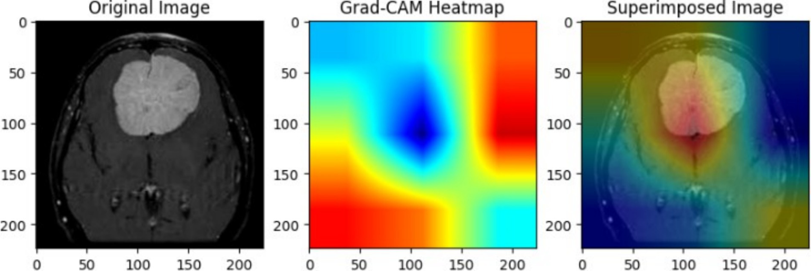
RESEARCH GAP
Unaddressed Limitations
The "Black Box" Challenge
Preprocessing Negligence
High-accuracy models only output a label. Without visual evidence, doctors cannot risk patient lives on blind AI predictions.
Many models skip automated 'Skull Stripping', allowing non-brain tissues to add noise to the feature extraction process.
FIG 5.1: THE NEED FOR EXPLAINABLE AI (XAI)

Slide 8



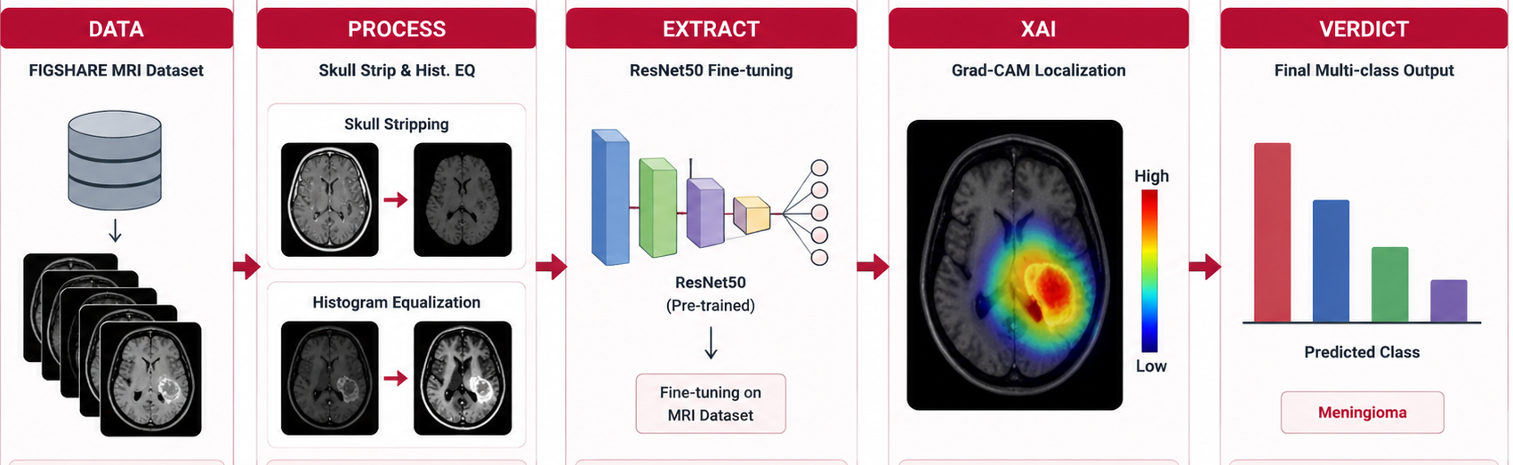
METHODOLOGY
Technical Execution Pipeline
1. DATA
2. PROCESS
3. EXTRACT
4. XAI
5. VERDICT
FIGSHARE MRI Dataset
Skull Strip & Hist. EQ
ResNet50 Fine-tuning
Grad-CAM Localization
Final Multi-class Output
FIG 6.1: END-TO-END SYSTEM FLOWCHART

Slide 9
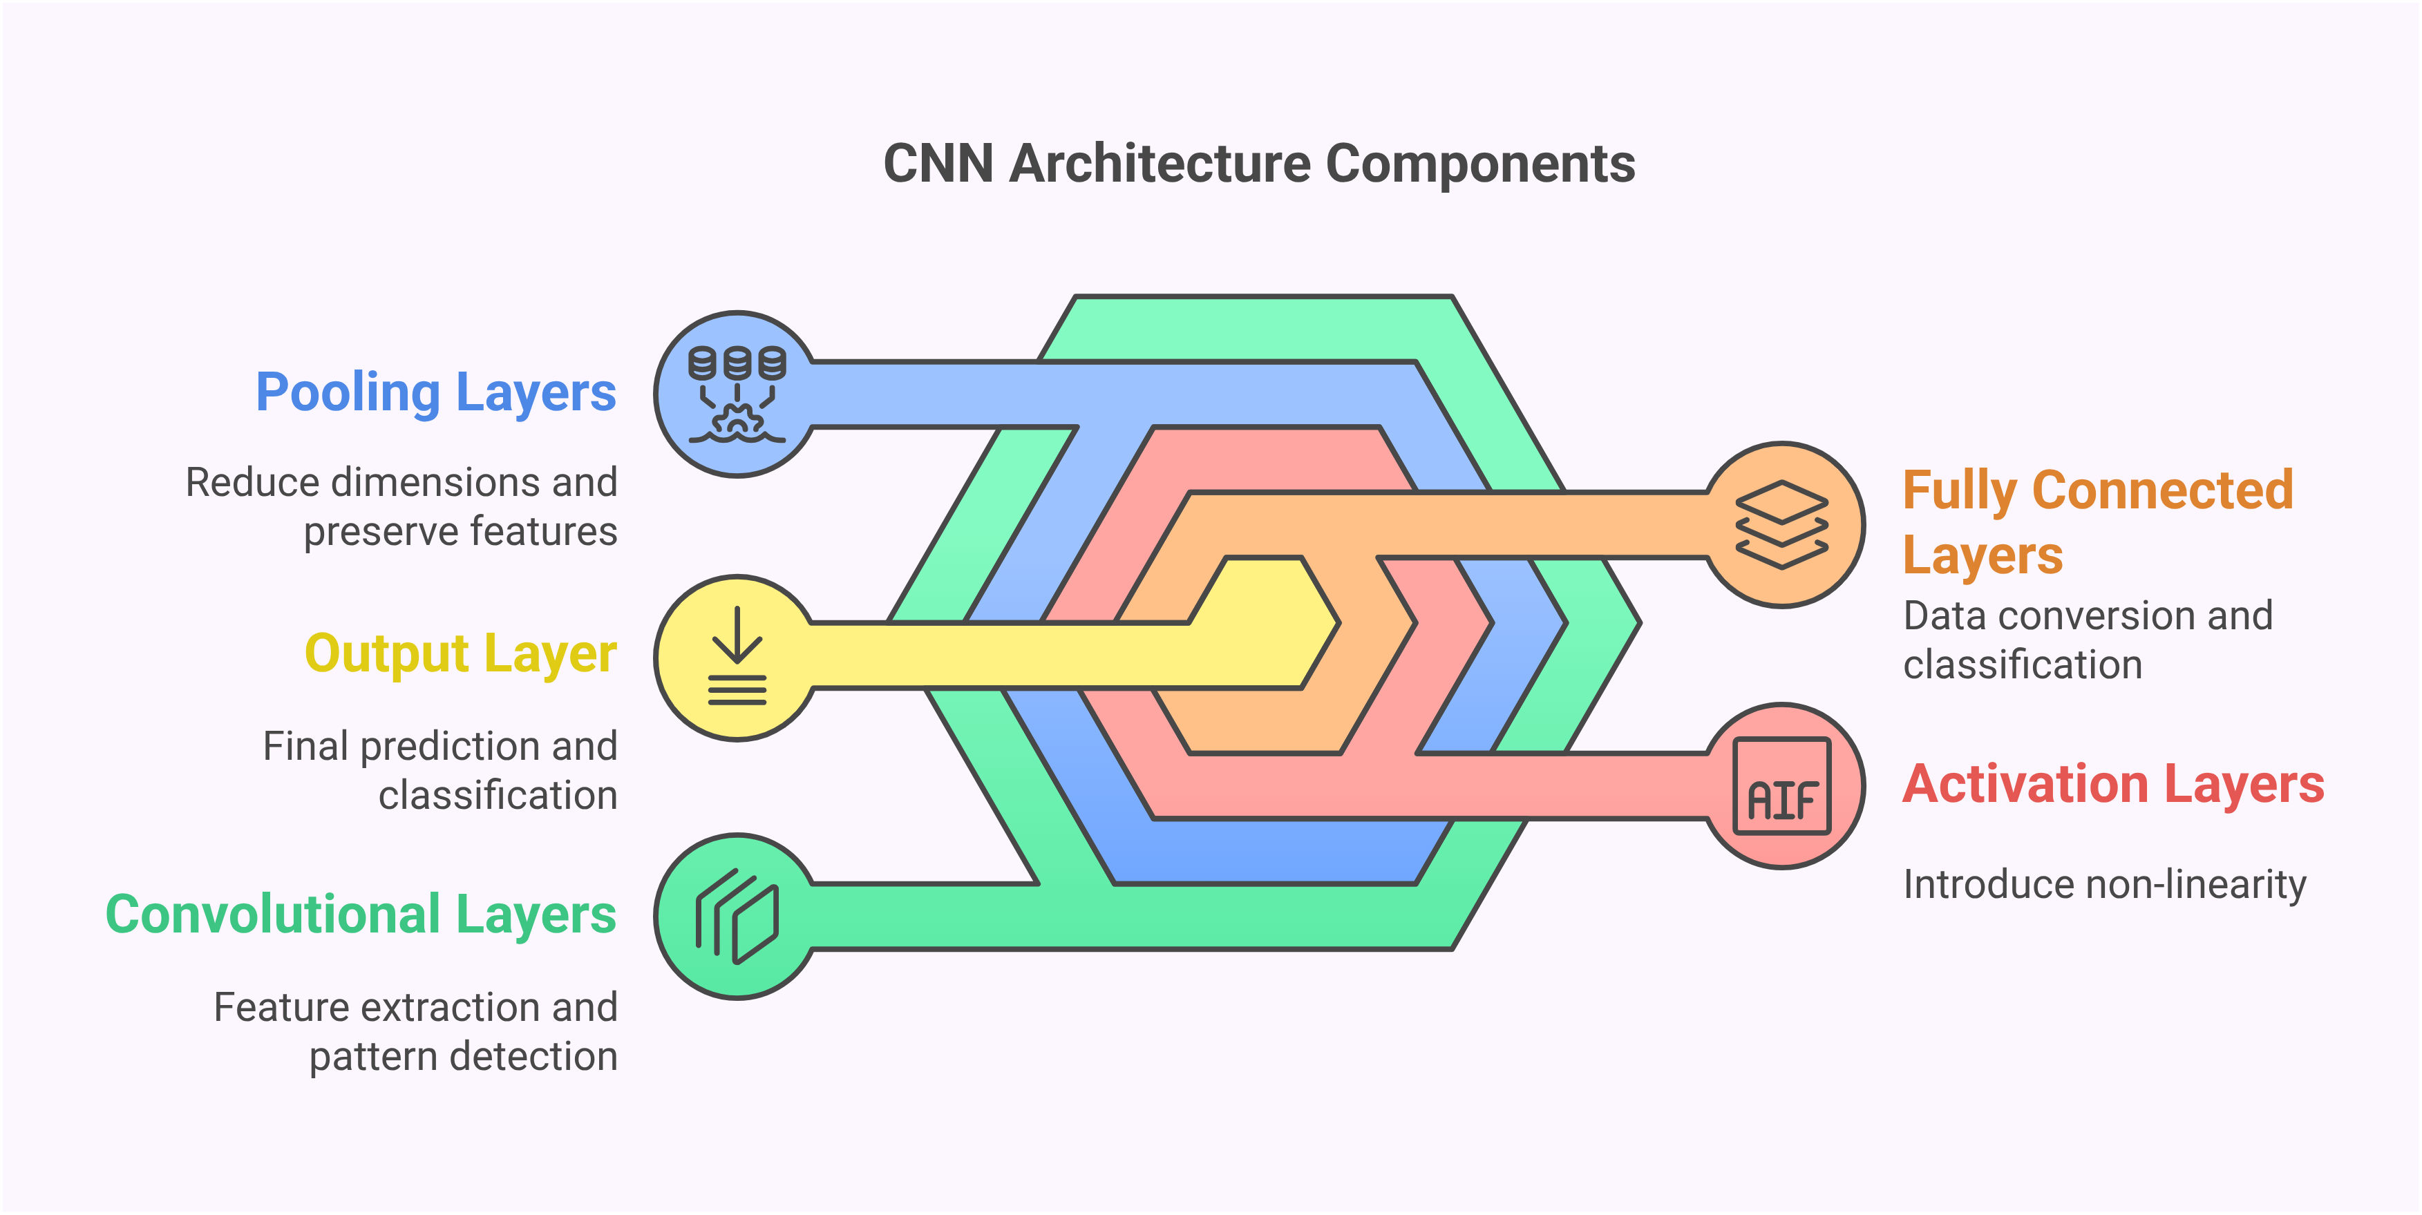
ARCHITECTURE
CNN Architecture Design (ResNet-50)
Skip Connections: Successfully mitigates the vanishing gradient problem, allowing the network to learn from 50 deep layers.
Transfer Learning: Weights pre-initialized from ImageNet to extract complex, high-level medical features instantly.
Global Average Pooling: Replaces dense layers at the end to drastically reduce parameters and prevent overfitting.
FIG 7.1: RESIDUAL BLOCK STRUCTURE

Slide 10



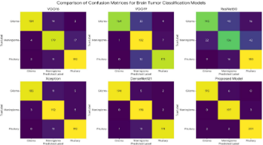
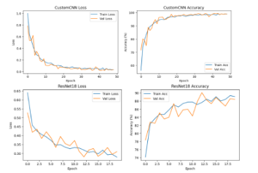
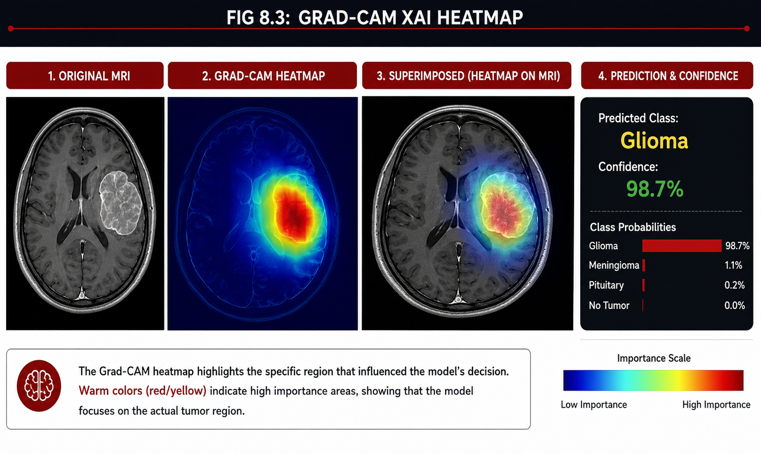
RESULT ANALYSIS
Performance Metrics & Visual Evidence
98.1%
97.6%
0.99
VALIDATION ACCURACY
F1-SCORE
AUC-ROC
FIG 8.1: CONFUSION MATRIX
FIG 8.2: ROC CURVE PLOT
FIG 8.3: GRAD-CAM XAI HEATMAP

Slide 11
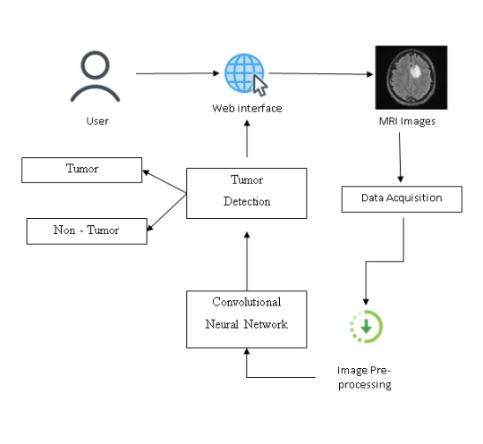
CONCLUSION
Final Summary & Clinical Impact
Diagnostic Precision: Our project successfully establishes a highly robust framework for brain tumour classification, achieving an accuracy of 98.1%.
Bridging the Trust Gap
By integrating Grad-CAM, we moved beyond the "Black Box." Providing visual heatmaps ensures that machine predictions are verifiable, fostering real-world clinical adoption and better patient outcomes.
FIG 9.1: THE FUTURE OF EXPLAINABLE MEDICAL AI

Slide 12
REFERENCES
Academic Bibliography
Sultan, H. H., et al. (2020). "Multi-classification of brain tumor images using customized CNN," IEEE Access.
Pereira, S., et al. (2016). "Brain tumor segmentation using CNN in MRI scans," IEEE TMI.
Ronneberger, O., et al. (2015). "U-Net: CNN for biomedical image segmentation," MICCAI.
Hossain, M. S., et al. (2022). "CNN based brain tumor classification using MRI," Future Gen. Comp. Systems.
Dataset Source: FIGSHARE Brain MRI Repository via Kaggle (2024).
H. Mohsen, E. S. A. El-Dahshan, and E. S. M. El-Horbaty, “Classification using deep learning neurFuture Computing and Informatics Journal, vol. 3, no. 1, pp. 68–71, 2018.

Slide 13
ACKNOWLEDGEMENT
THANK YOU!
Nitya Soni |Prakash Narayan |Prajwal Gupta |Sarthak Kumar
Galgotias College of Engineering & Technology, Greater Noida

